Slide 1

AN INTRODUCTION TO…… UNDERSTANDING ANGER
HELPING YOU UNDERSTAND WHY WE GET ANGRY AND FRUSTRATED. RECOGNISE RAGE, RESENTMENT AND THE CIRCLE OF GUILT.
UNDERSTAND THAT ANGER IS A CHOICE AND LEARN TO LET IT GO.
PRESENTED BY SHAUN DAVIS
1ST OCTOBER 2019

Slide 2

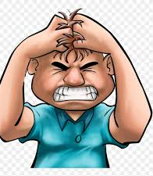
ANGER
IS IT GOOD FOR YOU?

Slide 3
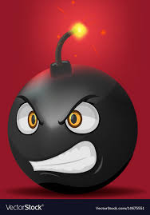
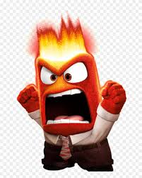
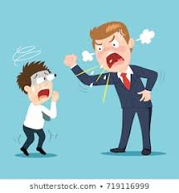
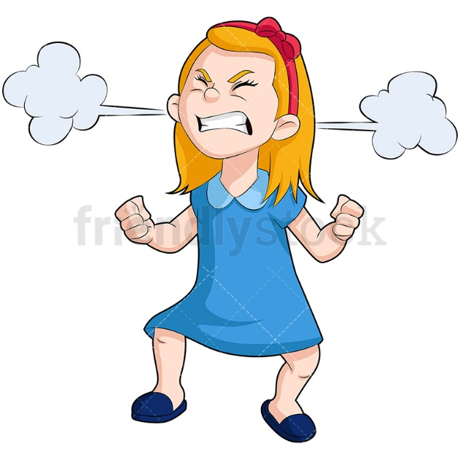

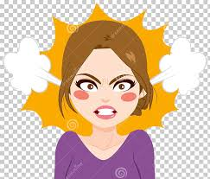
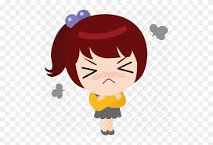
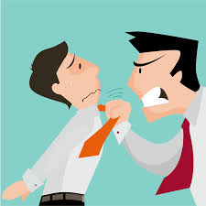
DO YOU RECOGNISE YOURSELF WHEN YOU GET ANGRY?

Slide 4
Anger is an emotion that tends to be easy to see. However, anger is often just the tip of the iceberg. Other emotions may be hidden beneath the surface.
ANGER
Anger triggers are people, places, situations, and things that set off anger. Your triggers can provide clues about the emotions behind your anger.
SADNESS DISAPPOINTED
LONELY OVERWHELMED
EMBARRASED HURT
In some families, anger is seen as more acceptable than other emotions. A person might express anger in order to mask emotions that cause them to fell vulnerable, such as hurt or shame.
HELPLESS PAIN FRUSTRATED
INSECURE HUNGRY GRIEF
ANXIETY STRESS THREATENED
TIRED CONTEMPT GUILT
Anger may be fuelled by different emotions at different times, or by a combinations of emotions. Sometimes, however, anger is just anger
JEALOUS SCARED
SHAME
Provided by TherapistAid.com

Slide 5
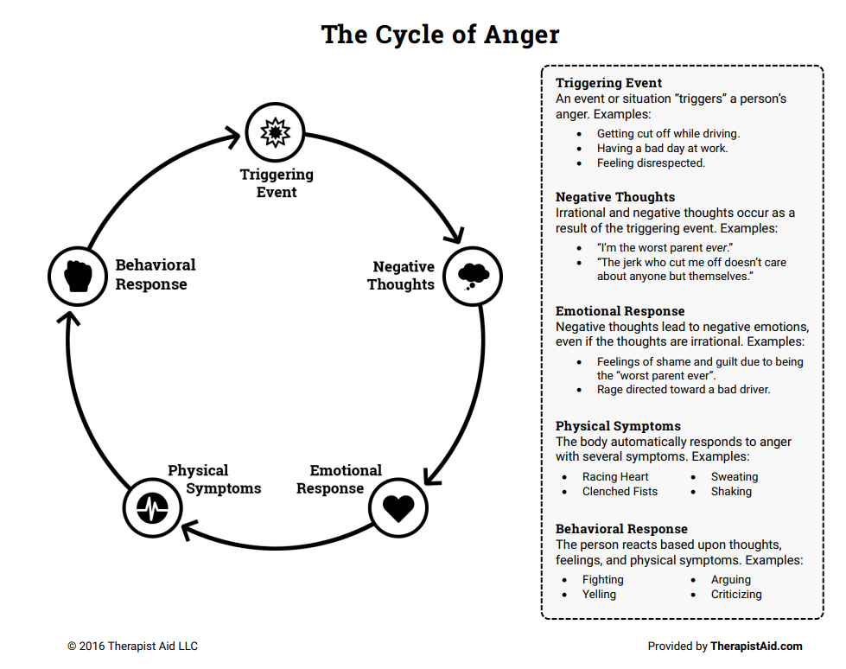

Slide 6
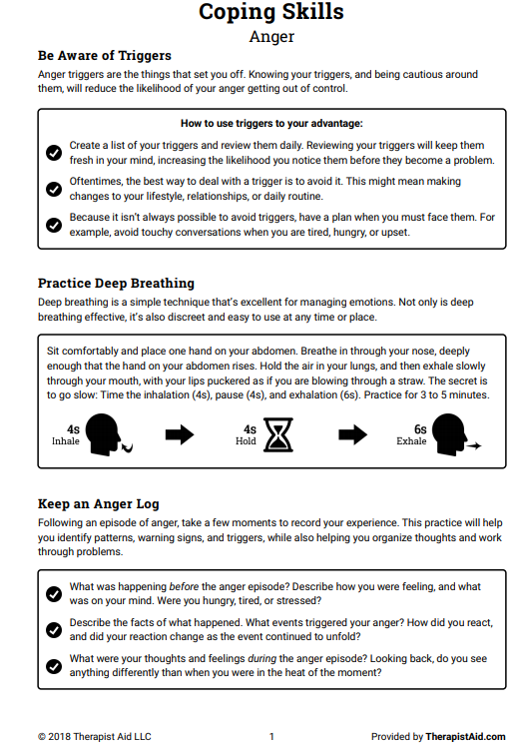
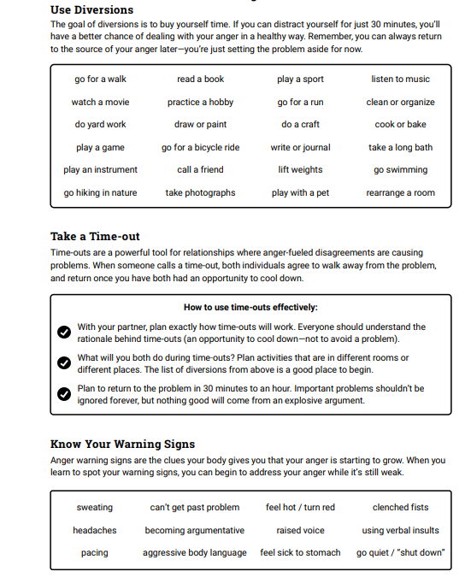

Slide 7
You could gather all your belongings, get your passport, and set sail. You could explore every inch of every shoreline, every state or county, every continent and country in the world. And you know what? Even if you searched for the rest of your life, you'd never... actually find the past anywhere!“
We can’t ignore the past, but we can put it behind us so that we can explore and discover the present and the future potential we all have within us.

Slide 8
We all constantly live in the present and make many choices about our futures because of the past. This is unavoidable. You can only read these words now because your mind relates to past experience with these words. All learning and knowledge rely on continually referencing the past, and many wise decisions about the future are created through recalling what has or hasn't worked before. You only recognize a friend in the street because you reference a past connection with them. In this way, you use the past well.
But doing things unquestioningly because 'it's always been that way' might be a misuse of the past. Tradition may be useful or it may prevent progress, depending on how useful it is. Personally, you have an emotional relationship to past events that steers you helpfully or unhelpfully in the present.

Slide 9
7 QUESTIONS TO HELP YOU DEAL WITH EVENTS AND HAVE AN APPROPRIATE REACTION
1. WHERE IS THIS ISSUE ON A SCALE OF 1 -1 10 ……………….ASSUMING 10 IS DEATH!
2. HOW IMPORTANT WILL THIS BE IN SIX MONTHS TIME?
3. IS MY RESPONSE APPROPRIATE AND EFFECTIVE?
4. HOW CAN I INFLUENCE OR IMPROVE THE SITUATION?
5. WHAT CAN I LEARN FROM THIS?
6. WHAT WILL I DO DIFFERENTLY NEXT TIME?
7. WHAT CAN I FIND THAT’S POSITIVE IN THIS SITUATION?
REFERENCE – PAUL McGEE the SUMOguy.com

Slide 10


Slide 11


Slide 12


Slide 13


Slide 14
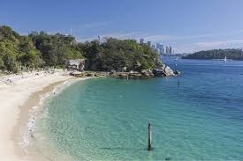

Slide 15
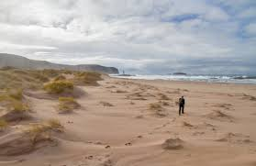

Slide 16


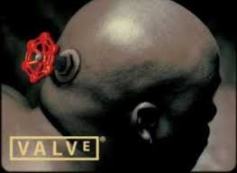

Slide 17
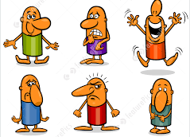
Always remember anger is a choice and it’s you who get to choose, nobody makes you angry, you choose to how you respond to an event or a person.

Slide 18
